Slide 1
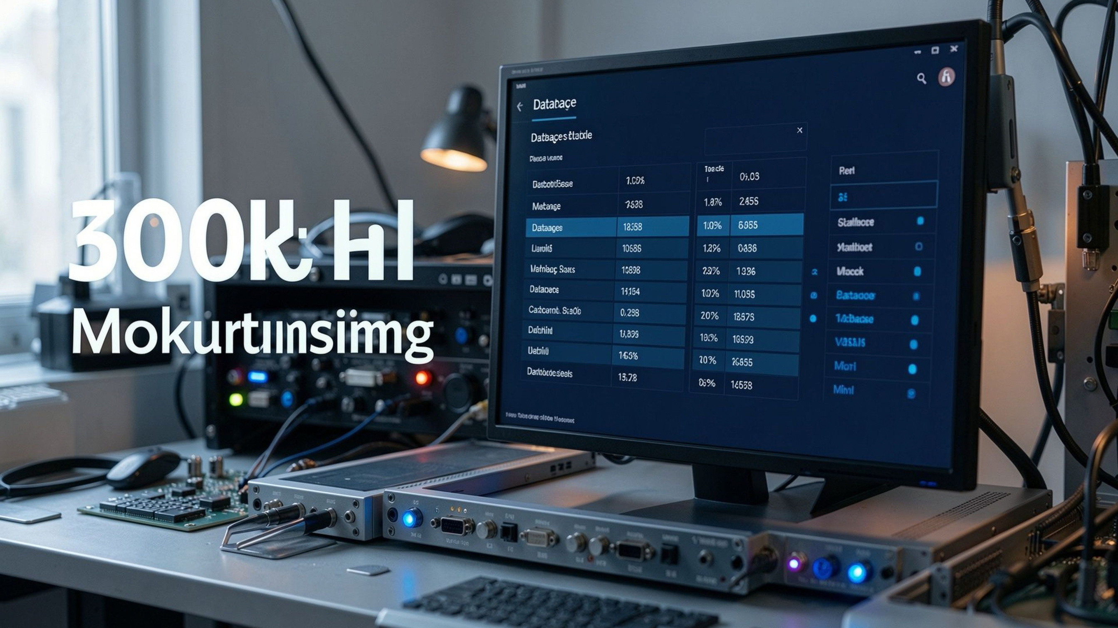
Internship Application and Progress Monitoring System
Presentation-III: Full-Stack UI Implementation, Dual-Mode RBAC & System Demonstration
MARTALA HARSHA VARDHAN REDDY | STUDENT ID: 25WU0102152
SCHOOL OF TECHNOLOGY, WOXSEN UNIVERSITY
GUIDED BY: DR. KIRAN MAYEE
Notes:
1

Slide 2



Three-Tier Architecture Keeps the System Modular
Presentation tier
Semantic HTML5, modern CSS Grid/Flexbox, and ES6+ JavaScript with zero heavy framework bloat.
Application tier
Node.js + Express.js REST APIs, non-blocking asynchronous routing, and mysql2/promise pooling with 10 concurrent connections.
Database tier
MySQL 8.0 with InnoDB on Port 3306, strict 3NF normalization, foreign-key cascading, and 3 performance views.
Notes:
2

Slide 3
The UI Makes Relational Data Easy to Scan
Header & navigation
Metric & KPI strip
Full-width view container
Two-column relational grid
dynamic count cards for 30 Students, 30 Companies, 30 Postings, and 30 Records.
live MySQL status on Port 3306 plus authentication mode trigger.
pre-joined view_active_postings directory avoids column truncation.
six relational tables with custom 6px slim scrollbars.
Design focus: zero horizontal clipping, contrast accessibility, and instant visual hierarchy.
Notes:
3

Slide 4
Dual-Layer RBAC Separates Experience from Enforcement
Viewer mode
Owner mode
Server enforcement
public read-only access; mutation forms and action buttons are suppressed from the DOM.
native HTML5 dialog with passkey authentication using Harsha@2026; insert forms and red delete actions appear dynamically.
custom Express requireOwner middleware checks the x-owner-key header on all POST and DELETE routes.
Security result: unauthenticated terminal or curl write attempts return HTTP 403 Forbidden.
Notes:
4

Slide 5
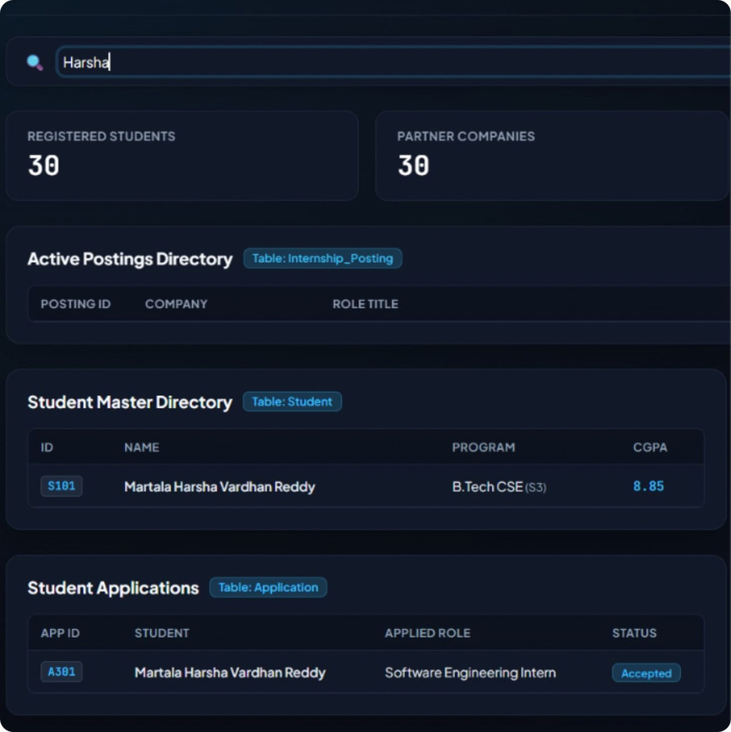
Viewer Mode Loads the Full Dashboard at Once
  Read-only browsing: Promise.all() fetches and renders all seven database tables asynchronously on page load.
  Global live search: keyup filtering scans every table row without repeated database calls.
  Search coverage: student names, IDs, companies, mentor names, and status flags.
  Interaction target: under 10ms client-side response time for substring matching.
Notes:
5

Slide 6
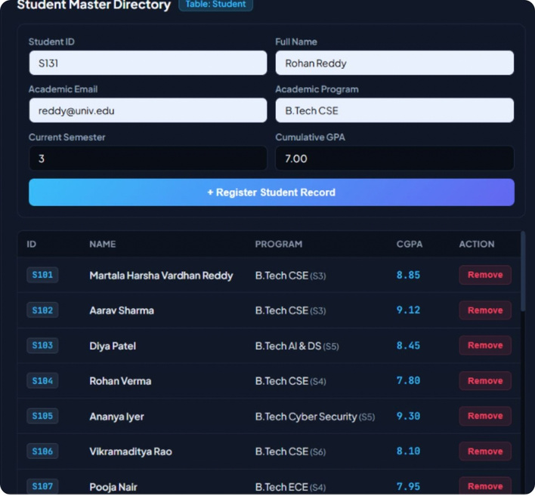
Owner Authentication Unlocks Safe Record Insertion
  Open the native modal and verify credentials through /api/verify-owner.
  Validate academic inputs: Student ID, Name, Email, Semester, and CGPA.
  Submit structured JSON asynchronously to Express through a POST request.
  Synchronize the DOM and update the table row without a full page reload.
Notes:
6

Slide 7

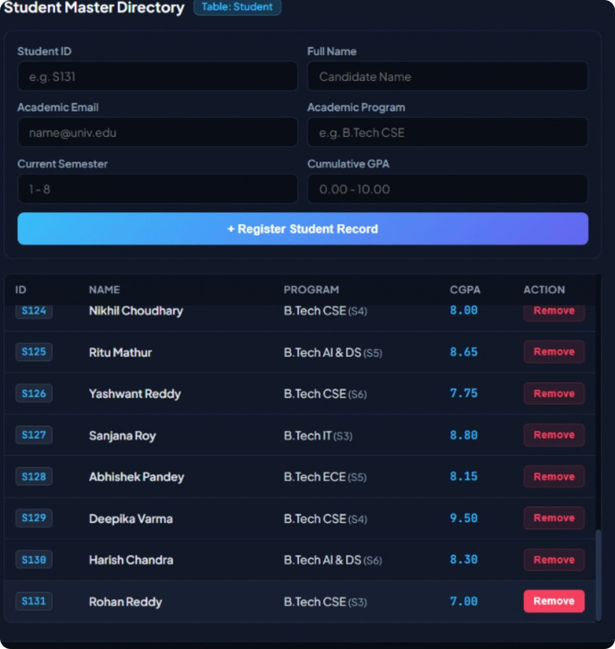
OWNER MODE · REFERENTIAL INTEGRITY
Foreign-Key Cascades Keep Deletion Clean.
  Dedicated Remove triggers appear only in Owner Mode, keeping destructive actions out of the viewer experience.
  Native browser confirmation prevents accidental deletions before a request is sent.
  DELETE requests pass server-side validation before the database mutation is allowed.
  Deleting a parent student or posting cleanly purges linked application rows and progress milestone logs through InnoDB ON DELETE CASCADE.
  The result is a consistent relational dataset with zero orphaned data.
DELETE FLOW
OWNER CONFIRMATION → VALIDATED DELETE → CASCADE CLEANUP
Notes:
7

Slide 8
Testing Confirms the Core User and Data Flows
Seeded benchmark dataset: 30 rows per table, 210 relational records total.
Test case | Result
TC-01 Page load & multi-view rendering | PASS
TC-02 Owner mode passkey handshake | PASS
TC-03 Security middleware route guard, 403 on raw POST | PASS
TC-04 Record creation & DOM update | PASS
TC-05 CGPA check constraint, CGPA ≤ 10.00 | PASS
TC-06 ON DELETE CASCADE referential integrity | PASS
TC-07 Real-time global substring filter | PASS
Notes:
8

Slide 9
From Fragile Spreadsheets to an ACID-Compliant System
  Technical milestone: delivered a 3NF-normalized web application with a reliable relational core.
  Repository: Public GitHub structure includes /Presentation-I, /Presentation-II, /Presentation-III, and /Project-Report.
  Deliverables: complete source code, SQL seed dumps, ER diagram, and UI verification screenshots.
Thank You / Q&A
Notes:
9

